Slide 1
Multi-Content Servers Setup
Sagar GVAV
05/05/2012

Slide 2
Agenda
Overview
Considerations
How to setup Multi-Content Servers
Troubleshooting

Slide 3
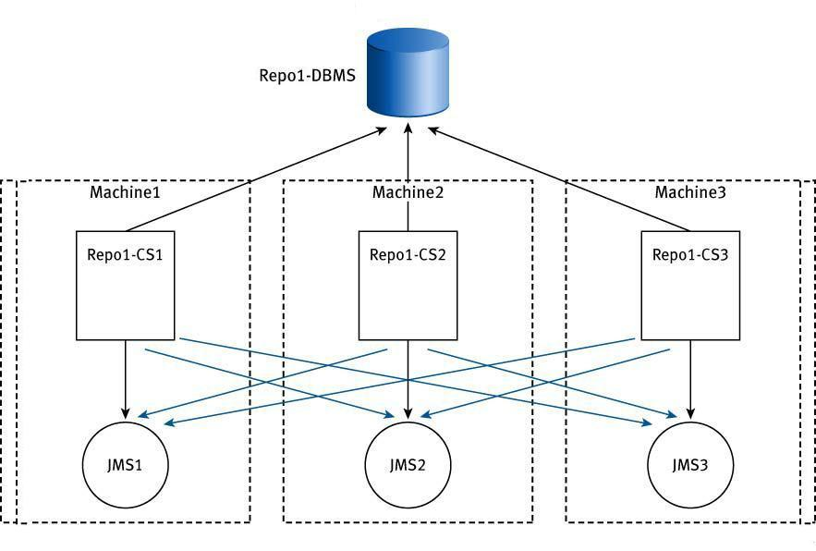
Overview (Multi-Content Servers setup done by Load Balancing)
Load Balancing is a methodology used to distribute workload across two or more computers..
To be more clear..Documentum Content server Load Balancing means subsequent client requests are distrubuted to two or more content servers to distrubute the load
Failover is a technique that involves automatic switching over when one computer fail
To be more clear on Fail over. If one content server had failed all the client requests are switched to the second server working in parallel to first content Server
Notes:
Overview
What this means is that multiple servers can serve one or more repositories at the same time. In the regular basis you will have one Content Server with one or more repositories. But you can have multiple-Content Servers serving one repository that can be host on the same machine or different machines.
It will enhance performance in general if you use multi-content server
Multiple servers also allow graceful failover if a particular server stops working.
You should use it when system availability is critical or Content Server performance is important or both are.
Due large number of users or lot of activity in the repository, Multiple Content Servers can be used to balance the load.
In some cases you can dedicate a server to a particular application or group of users, and then rest of servers to rest of the users.
There is a new simplified cfsConfigurationProgram to add or remove content server after binaries has been installed. This new program allows system to copy required files and configure new Content Server to service existing repository.

Slide 4
Overview
Multiple server machines should be available
Enhanced performance
Allow to have failover deployments.
Large user community to balance the load.
Simplified cfsConfigurationProgram.
Notes:
Overview
What this means is that multiple servers can serve one or more repositories at the same time. In the regular basis you will have one Content Server with one or more repositories. But you can have multiple-Content Servers serving one repository that can be host on the same machine or different machines.
It will enhance performance in general if you use multi-content server
Multiple servers also allow graceful failover if a particular server stops working.
You should use it when system availability is critical or Content Server performance is important or both are.
Due large number of users or lot of activity in the repository, Multiple Content Servers can be used to balance the load.
In some cases you can dedicate a server to a particular application or group of users, and then rest of servers to rest of the users.
There is a new simplified cfsConfigurationProgram to add or remove content server after binaries has been installed. This new program allows system to copy required files and configure new Content Server to service existing repository.

Slide 5
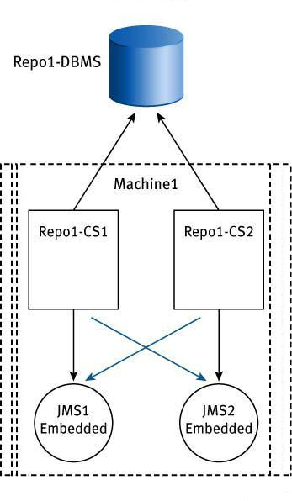
Glossary
Proximity value.
server.ini.
dfc.properties.
Private connection broker.
Trusted Login.
Notes:
Glossary
Proximity value – Is when Content Servers send a proximity value to each connection broker projection target. The proximity value represents physical proximity of the server to the connection broker. By default, clients connect to the server with the smallest proximity value since that server is the closest available server. If two or more servers have the same proximity value, the client makes a random choice between the servers.
Proximity values should have a value of 1 to 999, unless the content servers are in a distributed configuration.
Any server with a proximity value of 9000 to 9999 is considered a Content Server and typically only handles content requests.
For values from 1001 through 8999, the first digit is ignored and only the last three digits are used as the proximity value. For example, if for a proximity value of 8245, clients ignore the 8 and only consider 245 the proximity value.
On Windows platforms, proximity values of 10,000 and more represent servers in another domain. Users who want to connect to such servers must specify the server by name in the Connect command line.
Server.ini – Is the configuration file for the Content Server. The server configuration is defined by the server.ini file and the server configuration object. So during the server installation procedure creates both files automatically and the files are called when the server is started.
dfc.properties – is the configuration file that contains most of the configuration parameters that specify how DFC handles repository sessions. The configuration parameters are stored as a key and a corresponding value.
Private connection broker - process that provides client sessions with connection information, such as IP addresses and port numbers, basically is the same process as any connection broker, but the difference private connection broker and regular or public connection broker is that private connection broker will be used only be the local Content Server and nothing else and the public can be used by multiple Documentum applications such other content servers, or webtop, da, taskspace, etc.
Trusted Login – Which means is that specifies whether the client is allowed to create sessions for users without user credentials. For example using iapi in the Content Server you can test if trusted login is working.

Slide 6
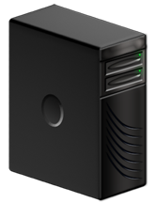

Architecture of Multi-Content Server
Application Server Cluster
Primary
Connection
Broker
Content
Server
Primary
Application
Server
Database Cluster
Default
Full-text
Subsystem
Content
Store
Database
Store
RDBMS
Browser
Cluster Load Balancer
Content
Server
Standby
Full-text
Subsystem
Backup
Application
Server
Content
Store
Database
Store
RDBMS
Second
Connection
Broker
Notes:
Architecture of Multi-Content Server
First we will have the browser that will connect to the application server, in this case Load balancer is used and then this will send the request to the application server.
Then a connection broker will be contacted and provide the information of the repository so application server can connect directly to the Content Server
Content Server will have multiple components and will be connection to Content storage, Fulltext index
Then it will be using a database.
As you can see; this is the flow that you will see when setting up multi-content servers

Slide 7
Agenda
Overview
Considerations
How to setup Multi-Content Servers
Troubleshooting

Slide 8
Considerations
Individual server configuration objects and server.ini file
On Windows:
Sc.exe program must be available
DESCRIPTION: SC is a command line program used for communicating with the Service Control Manager and services. USAGE: EXAMPLE: sc start My Service
On Unix:
Installation account of the primary host must have sufficient privilege to execute remsh commands.
Same install owner account for all Content Servers
All hosts configure must be set to the same UTC time.
Notes:
Considerations
Unique service names - It requires unique service name in the case that you will install a new Content Server instance on the same server.
Also it needs to have the same trust level - Servers servicing one repository must be all non-trusted servers or all trusted servers. It is not possible to have trusted and non-trusted servers servicing one repository.
Individual server configuration objects and server.ini files - On a Windows or Unix host, each server must have its own server config object and server.ini file and startup script.
For Windows hosts: The primary installation account must be in the domain administrators group. So the program SC.EXE must be installed in System32 directory. This is used to create and start services for Documentum servers.
And for Unix host: The installation account of the primary host must have enough privilege to execute remsh commands, which allow you to execute specified command at the remote host or just simply logs into the remote host and of course the primary host must be able to resolve target machine names through the /etc/hosts file or DNS.

Slide 9
Considerations
If original connection was started with a single-use login ticket to the original server, the session cannot be reconnected to a failover server because the login ticket cannot be reused
Server.ini file
For new CS file name will be: server_<machine_name>_<service_name>.ini
Data directory must be shared and visible to all Content Servers
Either using SAN or NAS, all content needs to be accessible by install owner account.
Notes:
Each server.ini file for new Content Server will contains the name of the machine and service name as described.
The Data directory must be a shared drive and visible to all Content Servers, you can either use SAN or NAS, but really important, all content needs to be accessible by install owner account, since is the only account that will be accessing the content
You need to use the same install owner account for all Content Servers
You need to configure all machines with the same UTC time, either you use pacific, central or any other time, all servers must have the same time.
Now you need to be aware that in the case that the original connection was started with a single-use login ticket or a login ticket scoped to the original server, the session cannot be reconnected to a failover server because the login ticket cannot be reused from another server.

Slide 10
Agenda
Overview
Considerations
How to setup Multi-Content Servers
Troubleshooting
Helpful Links

Slide 11
Requirements for load Balancing CS
Database client software must be installed on content file server host
Values used on the primary and remote hosts for DB connectivity must be identical
CS and file store must be in the same domain
CS installation user account must be available on Domain
CS Installation user account must have full access/control to the file store

Slide 12
Requirements for load Balancing CS (Cont.…)
CFS Configuration installs CS with a proximity value of 9000 or more. Proximity decides distance b/w docbroker and CS.
Proximity must be less than 9000 to achieve failover
Proximity values of the Connection broker must be equal to achieve load balancing.
If the servers have identical proximity values, clients pick on the of the servers randomly
If the proximity values are different, clients will always choose the servers with the lowest proximity

Slide 13
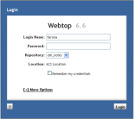
Multi-Content Server Setup
Setup Process 1:
Always check pre-installation requirements
Install server binaries in CS1
Configure Repository
Make sure you review all *.out and *_dar.log files to make sure everything got installed properly.
Configure a Private connection broker
Repository
Content
Server
Webtop, DA,
Taskspace or
any WDK app
* Always Install latest patches
Notes:
Multi-Content Server setup
We always advice to check pre-installation requirements that can be found in the Install guide
For example we show a Basic installation model and component installation order where you can see which components needs to be installed before, what is created during the installation and what components should be install after
Name and ID to assign a repository
Size and location of the content files
What kind of authentication you will be using, ports of the Content servers, user and password for the database
What Documentum licenses do you require and what global repository you will use?
Hardware and network requirements
Shared memory and semaphore requirements
SMTP and LDAP
Required rights for an installation owner account
Required environment variables
Specific database settings, depending on the database there is different specific settings that needs to meet before installing
Once you check that and you have everything you need, then you can proceed to install server binaries in Content Server 1, remember that a few Environment variables needs to be set before you do this on UNIX only.
Then Configure a Repository
Then once this is done you must be sure you review all *.output files and *_dar.log files to make sure everything got installed properly, because sometimes we find that some components are not working fine until we review these files and found that something went wrong while configuring.
Then you need to configure a Private connection broker, in a few slides you will know why this is important.

Slide 14
Multi-Content Server Setup
Setup Process 2:
Install binaries in CS2
Setup second Content Server for same repository using CFS program
Windows: cfsConfigurationProgram
Unix: cfs<OS>ConfigurationProgram
Configure Private connection broker
Content
Server
Repository
Webtop, DA,
Taskspace or
any WDK app
Content
Server
Notes:
Once you complete with Content Server 1, then install the binaries in Content Server 2
Once binaries are installed you need to setup second Content Server for same repository using program
Windows: cfsConfigurationProgram
Unix: cfs<OS>ConfigurationProgram you can locate this under $DM_HOME/install directory
Then again configure Private connection broker for that server as well.

Slide 15
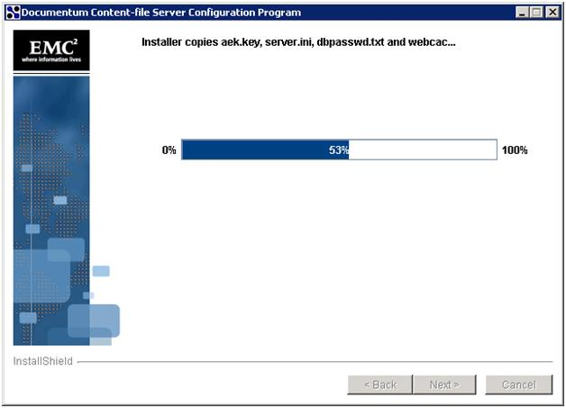
Multi-Content Server Setup
Setup Process 2:
This cfsConfigurationProgram will create and copy:
Server config object
aek.key
server.ini
dmpassswd.txt
ACS config object
Required jobs
Etc,
Notes:
This cfsConfigurationProgram will create and copy several files and objects such :
Server config object
aek.key
server.ini
dmpassswd.txt
ACS config object
All Required jobs
And of course it will install a new instance of the JMS
if you are using LDAP to authenticate the users, you will need to copy the .cnt file manually from the other content server to the new one and set the ldap_config_id to the dm_server config object.

Slide 16
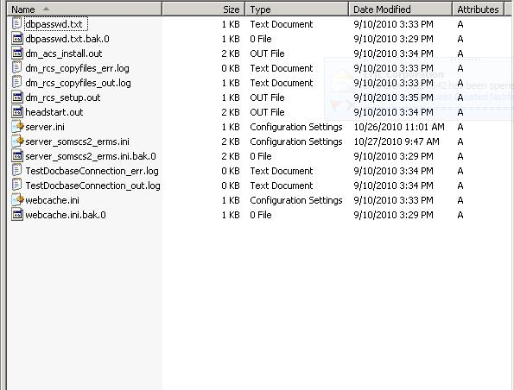
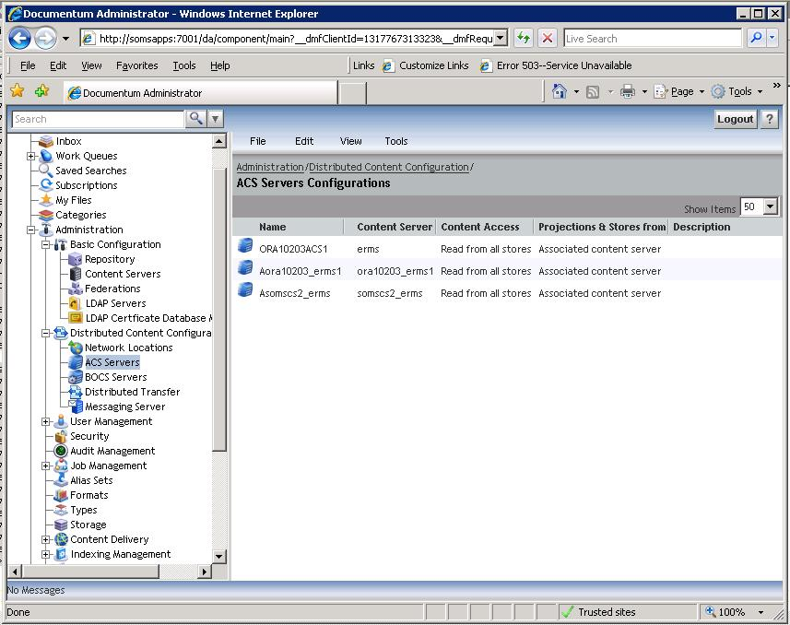
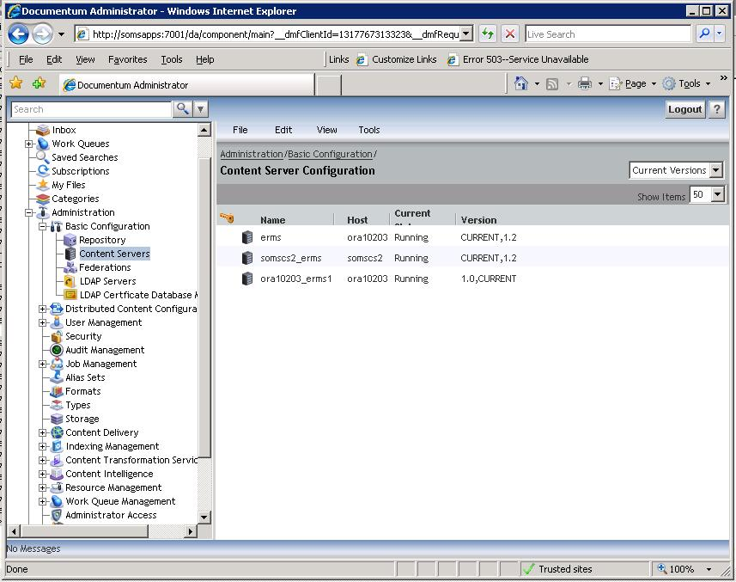
Multi-Content Server Setup
Setup Process 2:
When completes you will notice the following objects and files:
server_<hostname>_<repository>.ini
dbpasswd.txt
webcache.ini
aek.key
Etc,
Notes:
Multi-content Server setup
So when it completes you will notice in DA the server config objects
Acs config objects
And these files in the file system, so you will see that a few scripts got executed and as you can see, and the server.ini got copied but a new one got created which contains the name of the host and the name of the service.

Slide 17

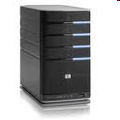


Configuration Scenario 1
System with Multiple Content Servers without any physical Load Balancer
Client Machines
Application
Servers
Connection Brokers
Content Servers
Repository
Notes:
Here we want to have a system with Multiple Content Servers without any physical Load Balancer, but want the load to be balance between Content Servers and be able to failover.
So here are you can see you will have the client machines talking to the application servers and these ones will talk to the connection brokers and Content Servers
How we can accomplish this?

Slide 18
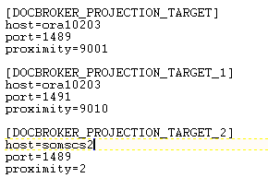
Configuration Scenario 1
As soon as a new remote CS (After CFS Configuration) is configured, server.ini will look like this:
Notes:
Configuration Scenario 1
So as soon as you configure a new remote Content Server, the server.ini will look like this:
The proximity values will be in the 9 thousands…

Slide 19
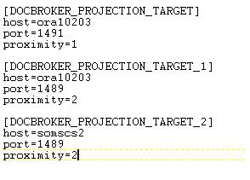
Configuration Scenario 1
Change proximity values in server.ini (Cross Projection Targets)
The servers used for load balancing must project identical proximity values
Notes:
So as I said before to accomplish the scenario that we want, we need to change proximity values in server.ini
So in this case the servers used for load balancing must project identical proximity values which basically will be using the public connection brokers and the local private connection broker will be 1

Slide 20
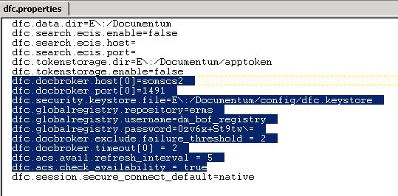
Configuration Scenario 1
Content Server dfc.properties should look like this:
This will help DFC to exclude the connection broker in case is down after 2 minutes.
Notes:
Configuration Scenario 1
Then content server dfc.properties should look like this:
Basically the connection broker will point to the private connect broker only which will be used for all local client connections such jobs, jms.
The parameter dfc.docbroker.exclude.failure_threshold = 2 will help DFC to exclude the connection broker in case is down after 2 minutes.

Slide 21
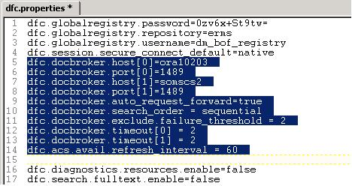
Configuration Scenario 1
App Server dfc.properties will look like this:
This will help DFC to return the available ACS URL after 2 minutes.
Notes:
Configuration Scenario 1
Application server dfc.properties file should look like this:
As you can see we have set both public connection brokers
The auto_request_forward is set to true
And serch_order is sequential so it will be sending the request to all available connection brokers in case the first one fails
The exclude.failure_threshold and timeout set to 2 will help DFC to return the available ACS URL after 2 minutes. So in the case that JMS is down or other content server is down or even connection broker is down these settings will allow to failover to the other content server after 2 minutes, why two minutes because is in the code. So after two minutes you will see that the entire requests will be going to the available Content servers

Slide 22
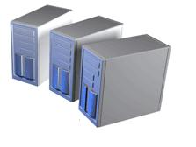
Configuration Scenario 2
System with Multiple Content Servers with physical Load Balancer in front of the application servers that host Webtop or Taskspace, so each app server will point to a different public connection broker.
Client Machines
Load Balancer
Application
Servers
Connection Brokers
Content Servers
Repository
Notes:
Configuration Scenario 2
In this case we want to have a system with Multiple Content Servers with a physical Load Balancer in front of the application servers that can host Webtop or Taskspace, so each app server will point to a different public connection broker.
So as you can see here, client machines will send request to Load balancer, and then load balancer will distribute the request to application servers and each application will send it to the content server.

Slide 23
Configuration Scenario 2
System with Multiple Content Servers with physical Load Balancer in front of the application servers that host Webtop or DA/DAM, so each app server will point to a different public connection broker.
Client Machines
Load Balancer
Application
Servers
Connection Brokers
Content Servers
Repository
Notes:
Configuration Scenario 2
In this case we want to have a system with Multiple Content Servers with a physical Load Balancer in front of the application servers that can host Webtop or Taskspace, so each app server will point to a different public connection broker.
So as you can see here, client machines will send request to Load balancer, and then load balancer will distribute the request to application servers and each application will send it to the content server.

Slide 24
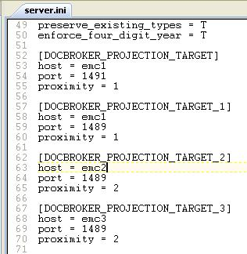
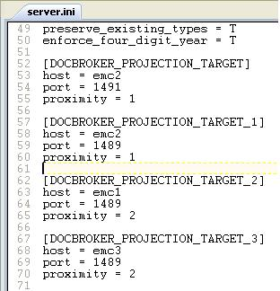
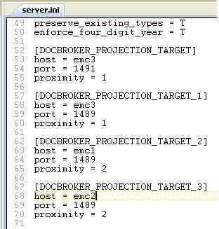
Configuration Scenario 2
Server.ini needs proximity 1 to local connection brokers and 2 to remote
Notes:
Configuration Scenario 2
So to make this happen each server.ini needs to project with proximity value 1 to local connection brokers and 2 to remote connection brokers
As you can see here all the different server.ini it shows that private and public connection brokers are set to 1 and remote public to 2

Slide 25
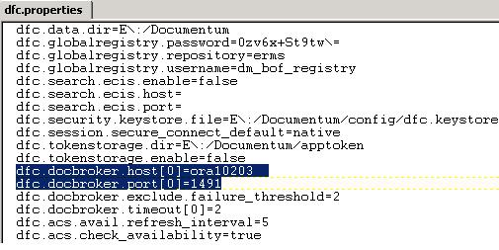
Configuration Scenario 2
dfc.properties in Content Server changes will be the same as previous scenario, only server.ini will be changed.
Content Server 1
Content Server 2
Notes:
Configuration Scenario 2
So dfc.properties changes will be the same as previous scenario, only server.ini will be changed.
As we can see here the settings are the same, only each Content server points to each local private connection broker

Slide 26
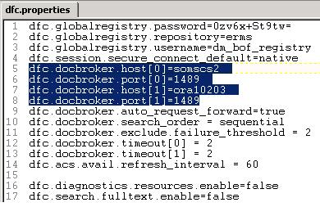
Configuration Scenario 2
dfc.properties changes will be the same as previous scenario, only order of projection will be changed.
Application Server 1
Application Server 2
Notes:
Configuration Scenario 2
Here the dfc.properties changes will be the same as previous scenario, only the order of projection will be changed, so each application server will point first to a different public connection broker.
So how does it work, basically each app server will always send the request to the first connection broker and since the local content server will have proximity value 1 on that connection broker the request will be always send to the nearest Content Server unless is down then it will send it to the next available server

Slide 27
Agenda
Overview
Considerations
How to setup Multi-Content Servers
Troubleshooting

Slide 28
Troubleshooting SR #1
Description of the issue:
When using Multi-Content Server setup LDAPSync job fails, if only one CS is up it works fine.
Steps taken:
Review job report and notice that issue was an authentication problem
Job Report shows this:
……
Source Ldap Config Names : [dm_all_directories]
Job Id : [080023828000038d]
2011-08-11 07:02:39 EDT: Connected to the Repository with the following parameters:
2011-08-11 07:02:39 EDT: Repository Name: TEST
2011-08-11 07:02:39 EDT: Repository Owner Name: dmadmin
2011-08-11 07:02:39 EDT: Repository Owner Domain: null
Notes:
troubleshooting Service request 1
Description of the issue:
When using Multi-Content Server setup LDAPSync job fails, if only one Content Server is up and running; it works fine.
Steps taken:
We request and review job report and notice that issue was an authentication problem
The Job Report shows this: and we notice that while running the job itself, it was trying to make a second connection and of course this connection will try to use trusted login. If configuration is not set properly it will try to do a trusted login against the remote content server instead the one that was launched, so that will make the authentication to fail. Remember that we talked about trusted login, so is expecting that the client that is trying to make the second connection is using the same IP address that the server is listening, but in this case it was sending the request to the remote Content server, so IP addresses didn’t match.

Slide 29
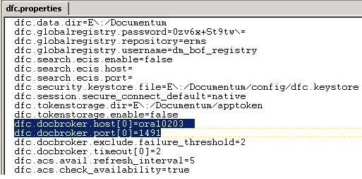
Troubleshooting SR #1
Description of the issue:
When using Multi-Content Server setup LDAPSync job fails, if only one CS is up it works fine.
Solution of the issue:
Add private connection brokers to each CS
Configure in the local dfc.properties of each CS to use private connection broker only
By doing that also will solve the issue of shutting down a CS and stopping another one.
Notes:
troubleshooting Service request 1
So the Solution of the issue:
Is to add private connection brokers to each Content Server
Configure in the dfc.properties of each Content Server to use the private connection broker only
And by doing these changes we will ensure that any trusted login will be done to the local content server and not the remote. Also will solve the issue of shutting down a Content Server and stopping another one.

Slide 30
Troubleshooting SR #2
Description of the issue:
Using Multi-Content Server with Load Balancing in front of a Taskspace Servers, we see that all the request goes to a single CS instead balancing within all Content Servers?
Steps taken:
Review configuration files such:
server.ini each CS
dfc.properties CS and app server
Server config objects
Notes:
troubleshooting Service request 2
Description of the issue:
Using Multi-Content Server with Load Balancing in front of Taskspace Servers, we see that all the request goes to a single Content Server instead balancing within all Content Servers?
Steps taken:
Review all configuration files such:
server.ini on each Content Server, dfc.properties of Content Servers and application servers, server config objects

Slide 31
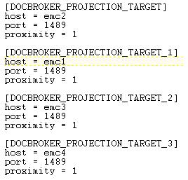
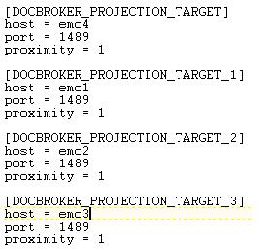
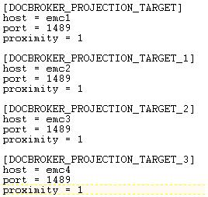
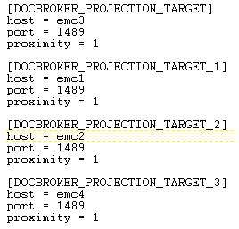
Troubleshooting SR #2
Description of the issue:
Using Multi-Content Server with Load Balancing in front of a Taskspace Servers, we see that all the request goes to a single CS instead balancing within all Content Servers?
Steps taken:
Notice that server.ini proximity value was set to 1 in all projections:

Slide 32
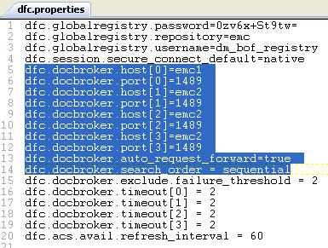
Troubleshooting SR #2
Description of the issue:
Using Multi-Content Server with Load Balancing in front of a Taskspace Servers, we see that all the request goes to a single CS instead balancing within all Content Servers?
Steps taken:
dfc.properties of all 4 app servers where using the same settings:

Slide 33
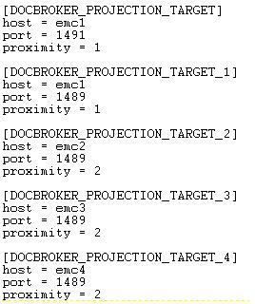
Troubleshooting SR #2
Description of the issue:
Using Multi-Content Server with Load Balancing in front of a Taskspace Servers, we see that all the request goes to a single CS instead balancing within all Content Servers?
Solution:
Add Private Connection Broker to Each CS.

Slide 34
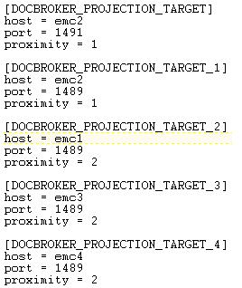
Troubleshooting SR #2
Description of the issue:
Using Multi-Content Server with Load Balancing in front of a Taskspace Servers, we see that all the request goes to a single CS instead balancing within all Content Servers?
Solution:
Add Private Connection Broker to Each CS.
Set proximity value for the non-local CS to “2” and leave local ones to 1.

Slide 35
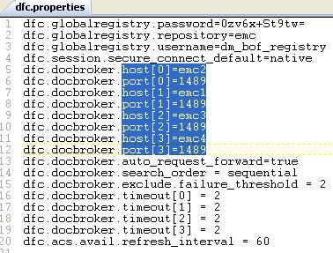
Troubleshooting SR #2
Description of the issue:
Using Multi-Content Server with Load Balancing in front of a Taskspace Servers, we see that all the request goes to a single CS instead balancing within all Content Servers?
Solution:
Add Private Connection Broker to Each CS.
Set proximity value for the non-local CS to “2” and leave local ones to 1.
In dfc.properties of each App server use different host[0] so load can be balance.

Slide 36
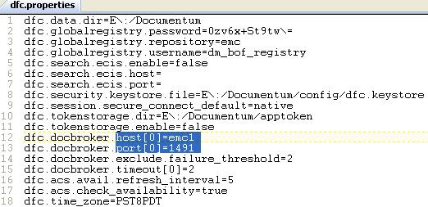
Troubleshooting SR #2
Description of the issue:
Using Multi-Content Server with Load Balancing in front of a Taskspace Servers, we see that all the request goes to a single CS instead balancing within all Content Servers?
Solution:
Add Private Connection Broker to Each CS.
Set proximity value for the non-local CS to “2” and leave local ones to 1.
In dfc.properties of each App server use different host[0] so load can be balance.
In dfc.properties of each CS use only Private Connection Broker.

Slide 37
Troubleshooting SR #3
Description of the issue:
dm_shutdown_<repo> script shuts down both content servers for the same repository when they were on same host.
Steps taken:
Review configuration objects and files
Found that one of the server config objects had wf_agent_worker_threads attribute set to 0:
……
dba_location : dm_dba
wf_agent_worker_threads : 0
wf_sleep_interval : 5
mail_method :
application_access_control : F

Slide 38
Troubleshooting SR #3
Description of the issue:
dm_shutdown_<repo> script shuts down both content servers for the same repository when on same host
Solution of the issue:
Confirmed with engineering and found that this is a defect.
As workaround attribute needs to be set greater than 0:
API> retrieve,c,dm_server where object_name=‘emc’ API> set,c,l,wf_agent_worker_threads SET> 3 API> save,c,l API> retrieve,c,dm_server where object_name=‘emc1’ API> set,c,l,wf_agent_worker_threads SET> 3 API> save,c,l

Slide 39
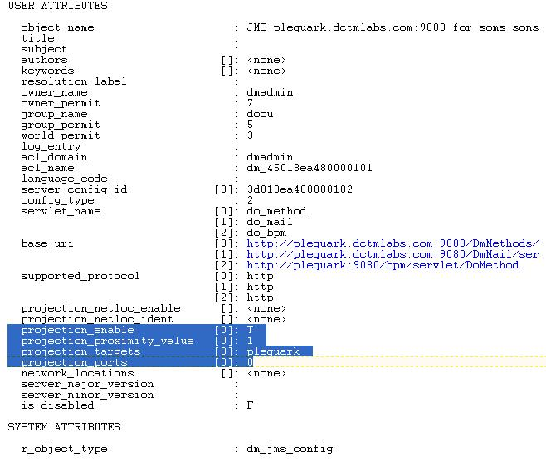
Additional Connection Broker
After 6.6 P06 and above such 6.7
IS NOT NEEDED
Why?
New type – dm_jms_config
Control projection and proximity values
Notes:
Additional connection broker in 6.6 P06 and above
Before we continue I need to tell you something about the additional connection broker or also known as private connection broker as I mentioned in previous slides, after 6.6 P06 and above such 6.7 guest what?
We do not need the private connection broker
And you may wonder why?
Because in 6.6 P06 and above there is a new type called dm_jms_config in which we can control the projection and proximity value, as you can see, by default will add the local host and proximity value 1, so with this now there is no need to have a private connection broker since this will be handle by this type and for example every time that you launch the LDAPSync it will know what is the local host to make the second connection, and the trusted login will work. So instead having two local connection brokers, one private and one public, you will need only one. But of course this is only if you are using 6.6 P06 or above. If you still have a 6.5 SPx then you should use the private connection broker. You may want to know why 6.6 P06

Slide 40
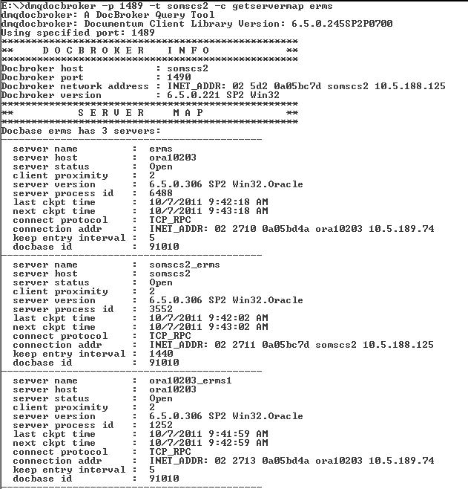
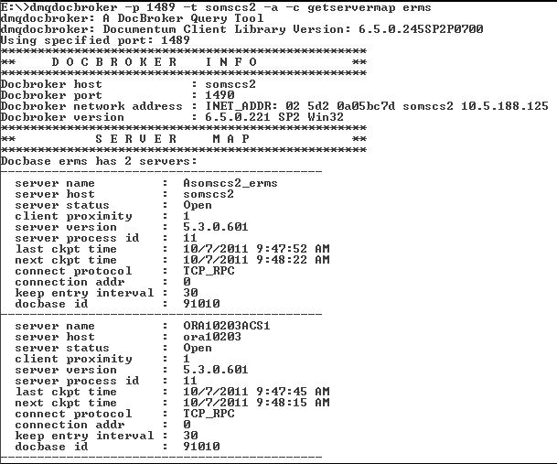
Troubleshooting Tools
dmqdocbroker tool
To check the proximity values and the status of the servers
To check the ACS servers available
Notes:
troubleshooting tools
One of the troubleshooting tools that we have available in the Content Server is the dmqdocbroker tool
This tool will help us to review information about the Content server
It will show the server name which is the server config name used, host, status which could be open or presume down, proximity value which in this case is important to know which one is the closer one. server version, what is the main process id, last ckpt time and next ckpt time, so as you may know the Content server will send the this information every 5 and will record the time that was done and the expected time for next execution. Also it shows the protocol and physical IP address and how long the connection broker holds this information when doesn’t receive the checkpoint broadcast and then at the end it will show the docbase id.
Also it can show the acs information as well.

Slide 41
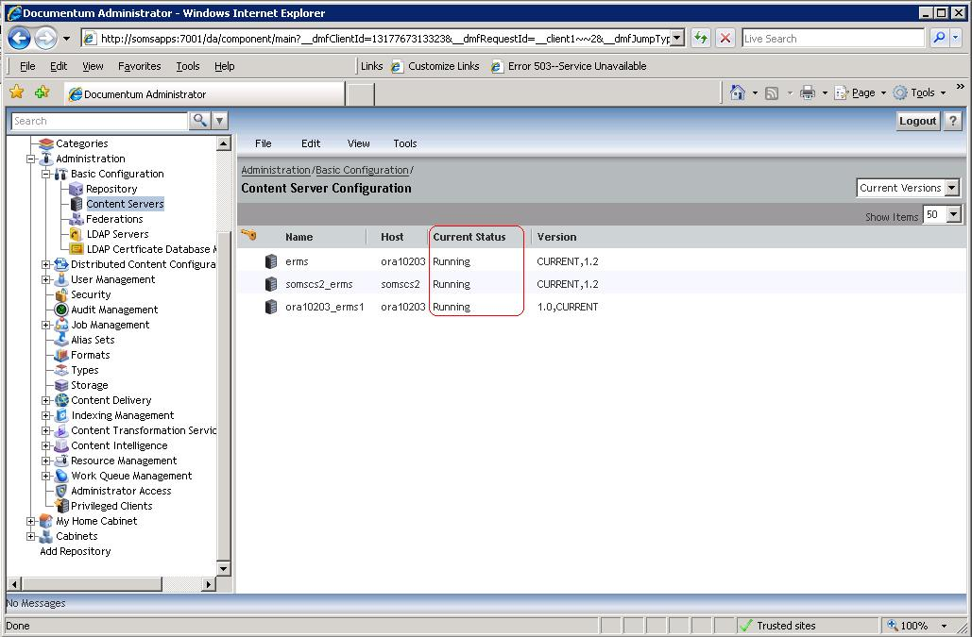
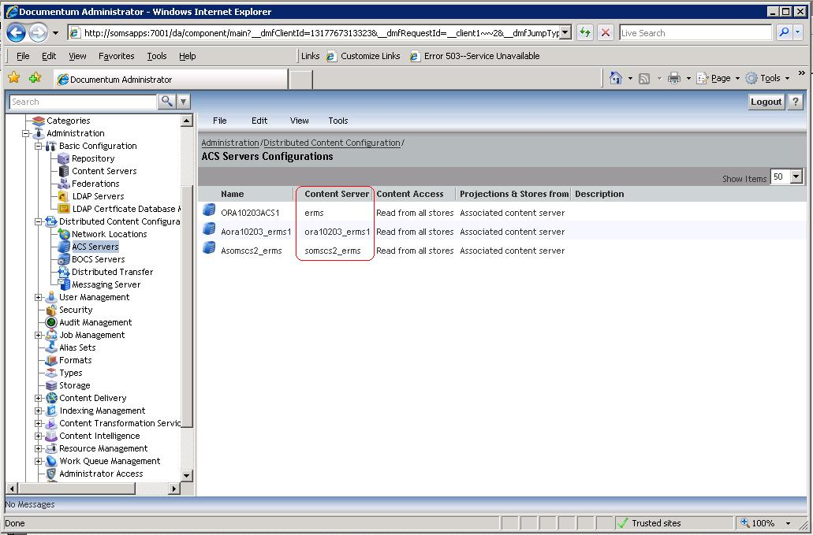
Troubleshooting Tools
Documentum Administrator
To check the status of the servers and ACS

Slide 42
Resources Posted to Powerlink
Support Solutions:
http://solutions.emc.com/emcsolutionview.asp?id=esg118430
http://solutions.emc.com/emcsolutionview.asp?id=esg90220
http://solutions.emc.com/emcsolutionview.asp?id=esg92067
http://solutions.emc.com/emcsolutionview.asp?id=esg116499
http://solutions.emc.com/emcsolutionview.asp?id=esg26691
http://solutions.emc.com/emcsolutionview.asp?id=esg122261
Notes:
42

